Slide 1

Nők az Ószövetségben
Női Szolgálatok vezető képzés
II. szint
Notes:
Introduction
It was from the womb of a woman blessed by God that the human race descended.
It was the hand of a woman that reached up and took the forbidden fruit from the tree of Knowledge of Good and Evil.
It was her lips that first pressed against the fruit as she, in disobedience to God, tasted the fruit and from that one act, sin in all its evil, dug its angry claws into God’s greatest and most loved creation – humanity.
But, it was also the womb of woman, untouched by man, that God used to cradle and bring forth the Savior of the world.
Woman has remained the same since Eve – we usually find ourselves in the thick of things – sometimes positively – sometimes negatively. But always, we find women who are deeply committed to God and often ready to be the first to tell the Good News or take a risk on His behalf.
Throughout the pages of scripture we find the stories of women who have shaped human history. We know the names of some, for others we find only a non-descript – nameless line or two. But always we find the traces of a woman who has gone before us, making a pathway for us in our journey toward God. Though we’ll look at the lives of several women in our study – there will be many others whose story we don’t have time to cover.
Women who with their own hands helped rebuild the walls of Jerusalem (Neh 3:12)
Women who led the nation in worship (Ps 68:25, Ex. 15:20,21)
Women who successfully lobbied for political change (Num. 27:1-11)
Women who served as prophets, judge, and Queens (Ex. 15:20; Judges 4:4)
Women who bore and raised up men and women who served God
In an age when women were not much more than a possession we find women who bravely stood against opposition be faithful to God and rescue their family. See 1Sam.25
It was a young Israelite girl being held in slavery who had compassion on her captor (Naaman) and told him about the prophet who could bring healing.
Women took the Narzarite vows alongside the men (Num 6:2) and separated themselves from the ways of the world to live a life dedicated to God.
When the new Pharaoh of Egypt, who didn’t know Joseph, ordered the death of every male Israelite male child as he was being born, the two Hebrew midwives, at the risk of their lives, refused to cooperate and the nation of Israel was once more secure (Ex. 1:16).
It’s as though we walk upon holy ground as we begin this journey in this study about the women of Old Testament times. Within every story, under every word – we find a glimpse of the heart of God. What he loved, what He despised, His willingness to work through the lives of women devoted to His word.

Slide 2

Debora
Elkötelezett nők a Bírák Könyvéből
Izrael története tele van háborúkkal
A harci történetekben a nők nem szoktak kiemelkedő helyet kapni
A nők szerepe Izrael harcaiban
A nők sorsa szorosan kapcsolódik Izrael sorsához
Notes:
As Israel stands on the borders of the Promised Land, it faces a daunting task. This group of wanderers must enter the land of Palestine, conquer it, and settle it. The book of Judges tells the story of this settlement period between the Exodus and the Monarchy. Here we find the stories of Ehud, Deborah, Gideon, Jephthah, and Samson. These are the stories told around the campfires of early Israel, stories of heroism and conquest, stories of the time when the judges ruled.
It was a time of war. War stories tend to be men’s stories. Women are not normally expected to be prominent characters in stories of warfare.
But in Judges 1, Achsah, the forthright daughter of Caleb, makes a surprise appearance on the stage of action, the first of many women to do so. In fact, understanding the prominent role that women take in this man’s world of wars and conquest has become one of the keys to understanding the book. Here we read the stories of Achsah, Deborah, Jael, the Certain Woman of the Abimelech story, Jephthah’s daughter, the many women of Samson’s life, Micah’s mother, the Levite’s concubine, and the host of wives and daughters that populate the stories of Judges.
As we will see, the fate of these women is intricately connected to the fate of Israel

Slide 3

Káleb lánya
Aksza – Káleb lánya
Aki elfoglalja a területet megkapja Akszát feleségül
Othniel elfoglalja Debirt
Káleb hatalmas hozományt ad a lányának
Aksza rájön, hogy vízforrásra van szüksége
Aksza áldást kér Kálebtől
Káleb két forrást ad neki
Aksza bölcsessége
Notes:
THE WISDOM OF ACHSAH
(Judges 1:11-15)
Achsah, like the other women in the book, appears where we would least expect to find her. The first chapter of Judges is an account, or a re-account, of the division of the land described in the Book of Joshua. It describes the cities taken and boundaries drawn and establishes the context for the hero stories to follow. It forms an unlikely backdrop for a wedding story. Rather, it moves us from the concerns of conquest to the concerns of settlement, from the world of war to that of peace, from the generation of Caleb to that of Othniel.
The story has the air of a fairy tale about it, with the familiar motifs of kings and challenges, daughters and heroes, battles and weddings. One might expect it to begin with “Once upon a time there was a mighty chieftain who had a beautiful daughter” and end with “They lived happily ever after.” In between, there simply has to be a wedding. The story presets a problem to be solved. An aging chieftain must conquer a city and arrange for the future of his daughter in a new and unsettled land. Can he do both at the same time?
The story begins as Caleb issues a challenge that connects these two concerns. The story of a daughter given as a reward for victory may set a modern reader’s teeth on edge. But this is the stuff of which good stories are made. Who can win the hand of the beautiful daughter? Only he who slays the dragon and saves the kingdom can have her hand. She is not the prize of a trivial tournament or a capricious game. She is a symbol of ultimate worth. My kingdom. My daughter. The safety and continuity of the kingdom are connected with her. Winning her hand requires feats of valor, which benefit the community. Here the challenge is one of the great Canaanite cities. Who is going to take the city of Debir? Only the wisest and strongest man in the land. Who is worthy of marrying the chief’s daughter? Only the wisest and strongest man in the land. “You want to marry my daughter? Bring me a city and we’ll talk.”
Caleb’s choice of a husband for his daughter proves to be a good one. Othniel is the first of the major judges, and a model one, at that. He does not assume leadership by any right of succession. He is chosen by the spirit of Yahweh. But by setting up his task and bestowing a rich dowry, Caleb ensures that worthy men are brought into positions of influence. The story could have ended at verse 12. Caleb issues the challenge; Othniel takes the city and marries the chieftain’s daughter. The action is complete.
But at this point, Achsah enters the story, and a new story begins. She is not a silent woman being transferred from one male custodian to another. She has lines. Not only does she have a name and an inheritance, but also opinions and a speaking part on this masculine stage.

Slide 4
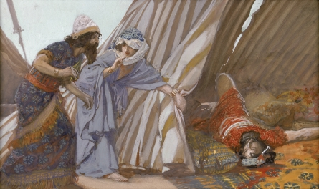
DEBora és JÁhEL
Sisera menekülés közben Jáhel sátráig futott
Jáhel behívja őt
Mialatt Sisera alszik Jáhel megöli őt
Debora and Bárák győzelmi éneket énekelnek
Notes:
DEBORAH AND JAEL (Judges 4:5)
The next woman we meet in the book of Judges is Deborah, the wife of Lappidoth, also translated as “woman of flame.” Deborah is the only one of the major judges who engages in what we would traditionally regard as the activity of judging. She sat in judgment under the palm of Deborah and the people of Israel came to her to resolve disputes. And she was also a prophet, one who had direct communication with God. The Song calls her a “mother in Israel.”
In this story Deborah calls Israel to war and conveys to Barak, the military leader, the strategy that God has given her to defeat the iron chariots of Sisera. Barak is hesitant. We don’t know why. Barak is one of the reluctant heroes of Judges. Maybe he is testing Deborah to see how much she believes in her own message; maybe he wants the assurance of God’s prophet with him when he faces the mighty power of the Canaanites. Whatever his reason, the story sets us up for a surprise. She will go with him, she says, but God will not give him the glory, but instead will deliver Sisera into the hands of a woman. But the woman is not Deborah. She is not even an Israelite. The surprise deliverer of Israel is Jael, the wife of Heber the Kenite.
Her story is told twice, once in the prose history of chapter four and once in the Song of Deborah sung on the day of victory. Jael is one of the unlikely heroes of the Book of Judges. Her clan was at peace with the Canaanite king Jabin from Hazor. But now Sisera, the commander of the armies, is on the run. He had gathered all his troops and his 900 chariots of iron at the Wadi Kishon ready to attack. Just when he had all his men and chariots arrayed for battle, Deborah rallies the Israelites for the Lord. She says to Barak, “Up! For this is the day on which the Lord has given Sisera into your hand. The Lord is indeed going out before you.” So, Barak and ten thousand warriors swoop down from Mount Tabor, and “The Lord threw Sisera and all his chariots and all his army into a panic before Barak.” At the end of the day, not one of the Canaanite forces is left but Sisera.

Slide 5

SISera Anyja
Sisera anyját megemlítik a győzelmi énekben
Hazavárja fiát a harcból
A fejedelemasszonyok magyarázatokat találnak a késésre
Sisera nem zsákmányon osztozkodik, Ő halott.
Izrael biztonságban van Istennek és egy nőnek köszönhetően.
Notes:
SISERA’S MOTHER (Judges 5:28-30)
One more woman makes an appearance in the Song of Deborah. A frequent motif in ancient Near Eastern art is the picture of a woman’s face looking out a window. I wonder if the singers of Israel were thinking of this when they sang of Sisera’s mother.
Out of the window, she peered,
The mother of Sisera gazed
Through the lattice
(5:28)
One might feel a tug of sympathy for a mother waiting for her son to come home from war. Whatever the differences in nationalities or politics, mothers are universal and mothers everywhere love their children. And like any mother who waits anxiously for an overdue child to come home, she wonders, “Why is his chariot so long in coming? Why tarry the hoof beats of his horses?” Any mother would sympathize, but what would the Israelite mother think when she hears what Sisera’s mother is thinking? Her wise ladies of the court answer her question; they affirm what she is thinking herself. Sisera is busy. What is he busy doing? He is dividing the spoil. In fact, he is picking out some particularly beautiful goods for her, embroidered clothes, carefully embroidered by Israelite women, something extra nice for her.
But that is not all. What else does she imagine her son dividing up? The Israelite women themselves -”a girl or two for every man.” She knows the customs of the times. The laws of Moses attempted to eradicate this custom by decreeing that the women of a defeated people be treated with respect (Deut 21:10-14), but Sisera’s mother knows of no such law. She doesn’t even have the natural sympathy of one woman for another. So, the Israelites have no sympathy for her. In fact, they know something that she doesn’t. She is in for a surprise. The wise ladies of the Canaanite court are wrong. Israelite women are not lying at the feet of Sisera. No, indeed. Sisera is lying dead at the feet of a woman. And once again the heroine of the hour is praised. God is praised. His is the victory. But his instrument is the woman Jael.

Slide 6
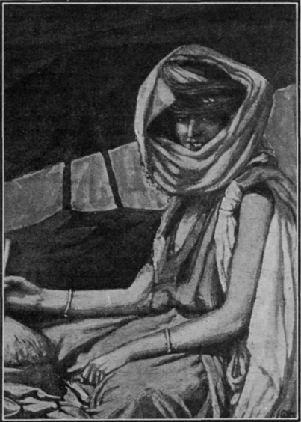
A nők Gedeon életéből nem ismertek, de jelentőség teljesek.
Gedeonnak 70 fia van több feleségtől His concubine from
Sikemi ágyasa fiat szült neki, neve: Abimélek
GeDEON családja
Notes:
THE FAMILY OF GIDEON (Judges 6-8)
Women play a very private role in the story of Gideon. One could read through the whole story and miss it entirely. We know about the call of Gideon, the test of the fleece, the test of the soldiers drinking from the brook, and the victory with torches and jars. It is a great story. But even this story tells us something about the women of early Israel. After the death of Gideon, the book tells us “Gideon had seventy sons, his own offspring, for he had many wives. His concubine who was in Shechem also bore him a son, and he named him Abimelech” (8:30-31).
The family life of Gideon with his 70 sons and many wives is very different than the marriage God designed in Eden. It is more like the marriages of Solomon, building up a kingdom with many wives. It is not like the carefully planned marriage that Caleb made for his daughter, matching her up with a hero and the first major judge. And there is another wife on the scene, a concubine from Shechem. The son of this wife will bring down the house of Gideon and bring widespread destruction in Israel.

Slide 7
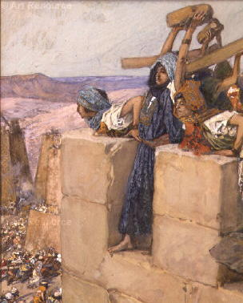
Gedeon halála után Abimélek mind a 70 testvérét megöli
Majd egy sereggel járja be Izraelt. Tönkreteszi a városokat és a termést és megöli a lakósokat.
Thébes városában az egész nép egy toronyba menekült
Amikor Abimélek megtámadja őket egy „bizonyos nő” egy malomkövet gördít a fejére és megöli őt.
Izrael ismét megmenekült egy nő cselekedete által.
Egy bizonyos nő Thébesben
Notes:
STONE FOR STONE: THE CERTAIN WOMAN OF THEBEZ (Judges 9:50-50)
After Gideon’s death, Abimelech, the son of the secondary wife, rises up against all the 70 sons of Gideon. Conspiring with his kinsfolk in Shechem, he kills all of his brothers “on one stone.” Then he goes on a rampage, destroying cities, burning fields. The Israelites have fought against many foreign kings, but this enemy is one of their own. He even burns down his own hometown of Shechem, killing about a thousand men and women.
When he approaches the neighboring town of Thebez, he intends to destroy it as he has the other towns. He approaches people as they are working peacefully in their fields, destroying people, crops, and cities. But this story is different. The people, “all the men and women and all the lords of the city” flee to a tower. When Abimelech comes to set fire to the tower, just as he did in Shechem, “a certain woman threw an upper millstone on Abimelech’s head, and crushed his skull.” An unexpected heroine again shows up on the scene. We don’t know her name. She is only known as “a certain woman,” but her action delivered Israel from a reign of terror. It did more than that. It punished Abimelech for the murder of his 70 brothers−on one stone. It was God’s punishment−stone for stone. The text says, “Thus God repaid Abimelech for the crime he committed against his father in killing his seventy brothers.” And he did so by the courage and resourcefulness of “a certain woman” who used an ordinary household implement in rescuing her city. Abimelech is a villain. He is a destroyer of home, family, fields, and cities, and even women take up arms against him. With Abimelech dead, the people of Thebez can return to their homes and peacetime work. “When the Israelites saw that Abimelech was dead, they all went home.”
The certain woman of Thebez−unlike Achsah, Deborah, and Jael, we don’t know her name. But Israel remembers her well. She is another of the unlikely heroes of the Book of Judges. And Israel remembers Abimelech, much to his dismay. He was conscious of his place in history, and before his death he called to his armor bearer and said, “Draw your sword and kill me, so people will not say about me, ‘A woman killed him.’” His attempt at image building didn’t do him any good. That is the main thing people remembered about him (See 2 Samuel 11:21).

Slide 8
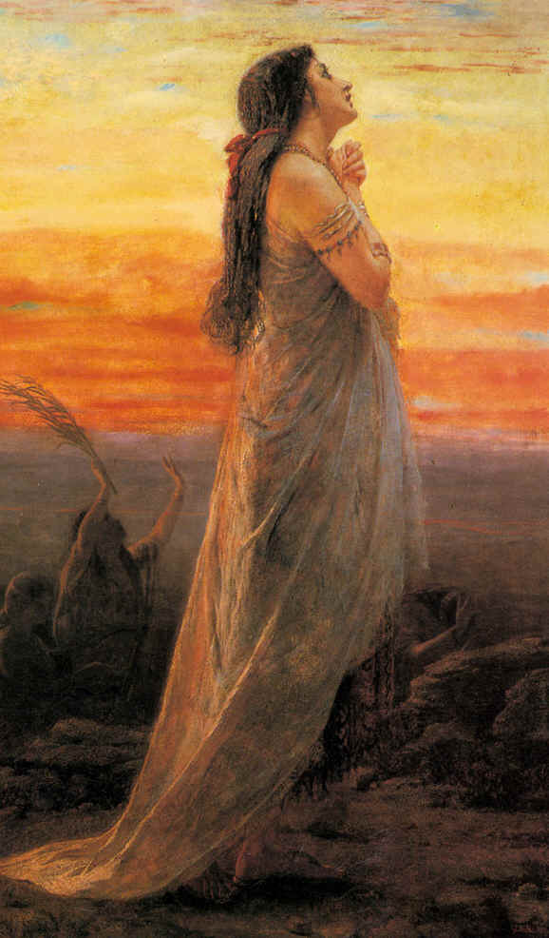
Jefte lánya
Jefté anyja prostituált volt, így a testvérei kitagadták őt
Jefté éppen egy győzelmi harcból tért haza, amikor a lánya kijött, hogy üdvözölje
Ez nagyon elkeserítette őt, mert fogadalmat tett Istennek, hogy győzelem esetén feláldozza Neki az első dolgot, ami elébe jön hazatértekor.
Lánya arra kérte, hogy tartsa be a fogadalmát, de előtte két hónapot kért, hogy elsirassa szüzességét a hegyekben.
Notes:
JEPHTHAH’S DAUGHTER (Judges 11)
From here, the stories of women in the Book of Judges become more perplexing. Jephthah’s daughter is another example of the father-daughter relationships. Both Caleb and Jephthah utter powerful words that affect the future of their daughters, but what a difference in the results. Jephthah returns home victorious from war with the Ammonites. His return should be a great cause for celebration. Typically, as we see in the story of David and Saul, the women of Israel will come out to greet the warriors coming home with timbrels and songs (1 Samuel 18:5-7). But the home Jephthah returns to is isolated, far up north in Gilead. He is the son of a prostitute and has been exiled by his father’s legitimate sons. Now, when he returns home, the only woman who comes out to greet him with timbrels and dancing is his daughter, his only child. What should be a joyous reunion is a tragedy. He has made a vow that “whoever comes out of the doors of my house to meet me, when I return victorious from the Ammonites, shall be the Lord’s to be offered up by me as a burnt offering (11:30-31). A vow is a bargain made with God. It is irrevocable. Once the words are out of his mouth, they cannot be changed.
The daughter knows that. Standing before her father and hearing his condemnation that she is the cause of his trouble, she replies, “My father, if you have opened your mouth to the Lord, do to me according to what has gone out of your mouth.” But she asks for time. A reprieve for two months, time to be with her women friends, time to grieve her lost life. Her name is forgotten. But the daughters of Israel remembered it, and for four days every year, they remembered their friend. So important was this remembrance that it became a custom in Israel.

Slide 9
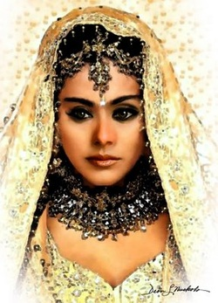
A bírák könyvében sok rövid történetet találunk a kis bírákról.
Ezek elbeszéli, hogy hol és mennyit élt a bíra, mikor halt meg és hova temették el.
Ibsán egy kis bíra volt, akinek 30 lánya és 30 fia volt.
Mindannyiukat gondosan összeházasította a törzsén kívüli személyekkel.
A gondos házasság tervezés által kibővítette törzsének szövetségeseit
Ez éles ellentétben áll Jefté ostoba fogadalmával, amely véget vetett családi vonalának.
Notes:
IBZAN THE MATCHMAKER
Surrounding Jephthah’s story is a group of very short narratives called the minor judges. Instead of telling stories of heroic deeds as we see in the major judges, they are written more like a ledger or log of rulers who live a life of peace and prosperity. Typically, these stories tell where a person lived, how long he ruled, that he died, and where he was buried. These are the ordinary events of a peaceful life. They hint at fruitful, prosperous lives building cities and families. Often, in the midst of these accounts, are details of family life.
Let’s take the story of Ibzan of Bethlehem as an example (12:8-10). His story immediately follows that of Jephthah. The basic information is that he lived in Bethlehem, judged Israel seven years, died, and was buried at Bethlehem. In between these events are 60 weddings. He is the grand matchmaker. He brings in 30 young women from outside his clan to marry his sons; and he arranges marriages outside the clan for his 30 daughters.
All of these marriages strengthen his family. Each marriage contract is designed with someone outside the clan to enlarge the clan’s alliances. Like Caleb, he thinks carefully about the marriages of the next generation. Like Gideon, he has many wives to establish this family; unlike Gideon, he does not compromise the unity and coherence of the family with outside influences.
Marriage is an integral concern in the stories of the Judges. At the beginning of the book, the seeds of discord were attributable to poorly chosen marriages outside the tribes of Israel. “They took their daughters as wives for themselves, and their own daughters they gave to their sons; and they worshiped their gods” (3:5-6).
Jephthah also fits this pattern. His story ends with the minor judge pattern:
“Jephthah judged Israel six years. Then, Jephthah the Gileadite
died, and was buried in his town in Gilead” (12:7).

Slide 10
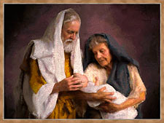
Sámson anyja meddő volt, míg egy angyal megjelenti neki, hogy fiat fog szülni és különleges utasításokat ad a felneveléséhez
Nazireusként kell felnevelni
Amikor az anyja elmondja apjának a jó hírt, az apa újabb látogatást kér az Úr angyalától
Az angyal újból megjelenik és elmondja, hogy ugyanazokat az utasításokat kell betartani, amit már elmondott.
Sámson nem egy példa értékű vezető
Notes:
SAMSON AND HIS MOTHER (Judges 13-16)
The life of Samson revolves around the women in his life. Now, instead of a father-daughter relationship, we have a mother-son relationship. The first and most important woman in Samson’s life is his mother, the unnamed wife of Manoah. Like many of the famous matriarchs of Israel, she was barren, but that is never a problem for God. In fact, it seems almost like a prelude to a wonderful birth of a great leader. Samson’s story glows with great hope.
An angel appears to his mother, announcing his birth and instructing her on how to raise him in the Nazirite life, as one dedicated to God, not for just a period of time, as were most Nazirites, but for his entire life.
When she tells her husband of the wondrous visitation, he entreats the Lord to let an angel come and teach them what to do. But, that is just what has happened. An angel has come and has told the mother how to raise the child. So, what is his question? Is it possible he does not believe her? Is he not able to hear a woman’s testimony? Whatever the reason for his prayer, God answers it and sends the angel to come, but again he comes to the woman and waits while she goes and gets her husband. In reply to his question of what they should do for the child, he only says, “Let the woman give heed to all that I said to her.” He adds a few partial examples of his instruction, but he does not repeat his entire communication. The instructions are to her. She is responsible for teaching the laws of God to her son. And she accepts God’s instructions without question. She knows him to be a messenger from God and pointedly does not ask his name. But Manoah probes into his identity and asks his name and invites him to dinner, as if he were an ordinary messenger rather than a divine emissary. When the angel disappears in a flame of fire, Manoah finally realizes who he has been talking to and is convinced that they will die. But his wife reasons it through. If the Lord were going to kill them, he would not have accepted their offering or announced a birth. The woman has received the word from the Lord and knows the Lord who has sent it. No wonder she was chosen as the mother of a leader in Israel.
But Samson is not the leader of armies that we have seen before in the heroes of Judges. He is a rogue, and when he does deliver Israel, it seems almost accidental, and always connected with his own desire for personal revenge.

Slide 11
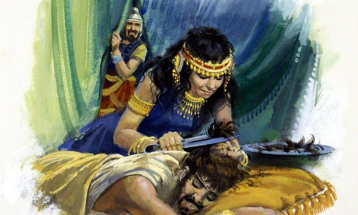
Több kapcsolata van filiszteus nőkkel
Arra kéri szüleit, hogy egy Timnátbeli nőt vegyenek neki feleségül, mely történet tragikusan végződik
Delila nem egy ártatlan nő a férfiak között
Ő intézi el a filiszteus vezérekkel, hogyan fedjék fel Sámson titkát.
Soha nem hazudik Sámsonnak, hiszen tudja, hogy erejének titkát keresi, hogy tönkretegye őt.
Delila eléri, amit akar, de Isten mégis felhasználja Sámsont, hogy megszabadítsa Izraelt.
Notes:
The stories of Samson, told around the firesides of ancient Israel, are stories of his relationships with Philistine women. He does not provide a model of the good marriage we have seen before. He asks his parents to arrange a marriage with a Timnite woman, “but his father and mother said to him, ‘Is there not a woman among your kin, or among all our people, that you must go to take a wife from the uncircumcised Philistines?’” But that marriage results in tragedy for the bride and her family and the entire city. The bride seems to be an innocent pawn in rivalry between men.
Delilah is different. Not an innocent pawn, she is the Philistine Jael. Though Samson is the hero, Delilah takes center stage. Her relationship with Samson has a purpose. She is to discover the source of his superhuman strength, so the Philistines can deal with this one-man army in their midst. She makes her own deal with the Philistine lords−there is no mention of her father. She speaks for herself. Her purpose is clear, even to Samson. She makes no attempt to deceive. She is utterly forthright in her purpose to discover his strength so he may be bound. It is a game. He plays her game for a while and then he seems to lose sight of his own purpose. He actually tells her his thoughts about it. But the game is deadly serious. This time Samson loses. Instead of throwing off the bonds as before, he is trapped and helpless, his great strength gone. Delilah has accomplished her purpose. But God will still accomplish his purpose through Samson, and though Samson’s own purpose is simply to avenge the loss of his sight, the result is the deliverance of Israel.

Slide 12

Míka ellopja anyjától az ezüst vagyonát
Az anya átkot mond a tolvajra.
Míka ezt hallva bevallja tettét és visszaadja azt.
Az anya megáldja őt és az ezüst egy részét felajánlja neki bálvány készítése céljából
Notes:
MICAH AND HIS MOTHER (Judges 17:1-4)
Right after the story of Samson is another story of a mother and son. The story introduces the chaos and barbarity of the final section. No longer are we talking about judges and deliverance. Now, all the people do what is right in their own eyes. Micah steals a fortune in silver from his mother; his mother curses whoever stole it, and Micah, hearing the curse, quickly returns the money and confesses his theft. The mother, in return, blesses him and consecrates a portion of it to be made into an idol and gave it to Micah for his household shrine. Thus it was in Israel. Sons steal from their mothers. Mothers, instead of teaching their children the ways of God, lead them into idolatry. Instead of speaking the laws of God, they speak blessings and cursings. God seems very distant. The story of the breakdown in family, the breakdown in community, and the breakdown in religion is an apt introduction to the tragic last story in the Book of Judges.

Slide 13
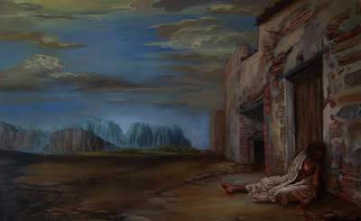
A lévita ágyasa visszatér atyja házához
A lévita elmegy, hogy visszahozza ágyasát
Késő este indulnak vissza és nem találnak szállást
Egy idős ember befogadja őket
Egy tömeg gyülekezik össze az idős ember háza előtt és kérik, hogy a Lévitát adja ki szexuális célokra
A lévita helyett az ágyasát adja ki, akit egész éjszaka megerőszakolnak
Notes:
THE LEVITE AND HIS CONCUBINE (Judges 19)
The story of the Levite and his wife is almost too painful to read. It is unrelentingly horrific. Every relationship is destroyed−father and daughter, husband and wife, host and guest, tribe and tribe. Israel has hit rock bottom. No one is given a name. Each person is known only by what should be an honored relationship with another. The main character is a Levite, someone who seems to know nothing of God. He takes a concubine, who is a secondary wife, but nonetheless, a wife. The marriage does not go well, and she returns to her father. After four months her husband goes to his father-in-law’s home to woo her and “speak tenderly” to her. But the only words spoken are between men. Throughout the story, she never speaks, and is spoken to only once.
The hospitality of the father-in-law is relentless. After a three-day stay, they prepare to go, but her father pleads, ‘Fortify yourself with a bit of food, and after that you may go.’ So the two men sat and ate and drank together.” Where is the woman he had come to woo? She is nowhere in sight. This is an exercise in male bonding. It delays their departure for five days, until late on the fifth day; they begin their journey home, too late to find lodging.
Upon arriving in Gibeah they stay in the city square until an old man invites them home, to another scene of hospitality. The obligation of the host to provide safety and protection for his guests extends only to the men. In a scene reminiscent of the story of Lot and his daughters, the host pleads with the gang that has surrounded the house demanding access to the Levite. He says, “No, my brothers, do not act so wickedly. Since this man is my guest, do not do this vile thing. Here are my virgin daughter and his concubine; let me bring them out now. Ravish them and do whatever you want to them; but against this man do not do such a vile thing.” It is not the host who throws the Levite’s wife out the door. It is the Levite himself: “So the man seized his concubine, and put her out to them. They wantonly raped her, and abused her all through the night until the morning.”

Slide 14
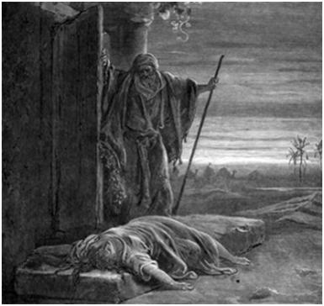
Reggel visszakúszik az idős ember ajtajához
A lévita felteszi a szamarára és hazaviszi
Amikor hazaérkezik rájön, hogy a nő halott. Testét 12 darabra vágja
A lévita a 12 darabot kiküldi Izrael 12 törzsének, akiket harcra hív a Benjámin törzse ellen.
A harc után csak 600 Benjáminita férfit hagynak életben
Notes:
The vignette of the concubine crawling back to the man’s house and falling across the doorway typifies the depravity of the story. In that scene every sacred relationship is violated. The Levite, now called her master rather than her husband, gets up the next morning, opens the door of the house, goes out the door, and sees her “lying at the door of the house, with her hands on the threshold,” says, “Get up. We are going.” These are the only words he speaks to the woman.
The next vignette not only captures the horror of the story, but it also invites comparison to the first woman we have met in the Book of Judges. When there is no answer to his command, he puts her on the donkey and sets out for home. Remember Achsah seated on a donkey, accompanied by her husband, on her way to her new home. What a difference. Achsah speaks freely with her husband and her father and is heard. The concubine is silent, never speaking, spoken to only once, though we can’t be sure if she could hear. We are not even sure as she rides on the donkey if she is alive. Her husband cuts her into 12 pieces, but the story never tells us when she died. But now her dead and dismembered body speaks volumes. It calls Israel to war, not against enemy invaders but against the tribe of Benjamin.
It is civil war−tribe against tribe in Israel. And they nearly wipe out the tribe of Benjamin. Only 600 men remain alive.

Slide 15
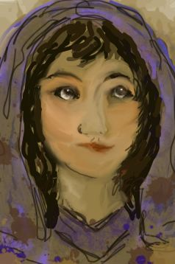
Az Izraeliták nem akarják, hogy egyik törzsük megszűnjön, így a 600 férfinak 600 új feleség kellett.
Rájöttek, hogy a Jábes- Gileád városából senki nem vett részt a harcban.
Megtámadták őket és mindenkit megöltek. Csak 400 szűz leányt hagytak élve.
Így 400 feleséget szereztek a Benjáminitáknak , de 200 még nőtlen volt.
A probléma abban volt, hogy az Izraeliták megesküdtek, hogy soha nem adják feleségül lányaikat a Benjámin törzsébe.
Notes:
All others are dead, including the women and children. Now, there is a problem. The Israelites realize that one of the tribes of Israel is on the verge of extinction. They come up with a plan to prevent it from happening. Since the city of Jabesh-Gilead did not respond to the assembly, they will wipe out that town, all the men and women and children, and kidnap the young virgins as wives for the remaining men of Benjamin. It almost worked, but only 400 young virgins survived, so they needed another 200. There is an additional problem. All the men of Israel had vowed to never give their daughters as wives to the men of Benjamin.
So they ask themselves, “What shall we do for wives for those who are left, since there are no women left in Benjamin?” And they said, “There must be heirs for the survivors of Benjamin, in order that a tribe may not be blotted out from Israel. Yet we cannot give any of our daughters to them as wives.”

Slide 16
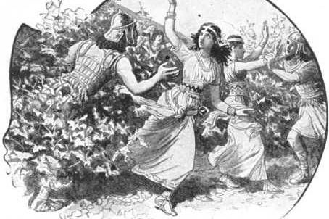
Az Izraeliták azt mondják a Benjámin törzséből megmaradt férfiaknak, hogy menjenek Silóba, ahol ünnep volt.
Leselkedniük kellett az úton és elrabolniuk azt a lányt, melyet feleségül akartak.
Az Izraelita vezetők megnyugtatták a lányok atyjait emlékeztetve őket, hogy a Benjáminitáknak feleségre volt szükségük, és mivel ők nem önszántukból adták , így nem hágták át az esküt.
Notes:
The problem is solved at Shiloh. A yearly festival of the Lord is celebrated there. The plan is simple. When the “young women of Shiloh come out to dance in the dances, then come out of the vineyard and each of you carry off a wife for himself from the young women of Shiloh, and go to the land of Benjamin.” If their fathers or brothers should complain to us, we will say “Be generous and allow us to have them; because we did not capture in battle a wife for each man. But neither did you incur guilt by giving your daughters to them.” The rape of one woman has turned into the rape of 600. Israel is at its lowest point. The refrain of the last few chapters is “In those days there was no king in Israel; all the people did what was right in their own eyes.”

Slide 17
Aksza története egy minta történet a Bírák könyvében szereplő többi nő történetéhez képest
Az ágyas nő története Aksza történetének végső ellentéte
Sok nő a Bírák könyvéből Aksza intelligenciáját és független lelkületét tükrözi.
Aksza története bemutatja azt, ahogyan a dolgoknak történnie kellene
Az ágyas történetében a dolgok a lehető legrosszabbul történnek
Ruth története egy újabb példa számunkra
Notes:
FROM ACHSAH TO THE CONCUBINE
The spirit of Achsah is often noted in the rest of the book of Judges. Just as the story of Othniel is seen as a pattern for the rest of the major judges, so the story of Achsah is seen as a model for women in the book. The model she provides is often turned upside down. The story of Achsah, the Israelite bride who brings her husband wealth, is set against the story of Samson whose foreign wives bring him disaster. The marriage of Achsah to a hero of the tribe is set against the marriage of Gideon to a concubine, which produces the villain Abimelech who destroys the family and nearly destroys Israel.
The story of the concubine seems the ultimate contradiction of the story of Achsah. The contrasting images of two women riding on a donkey, one a bride, the other a concubine; one talking to her husband and father, the other silent; one establishing a new home in a fertile land; the other dead and cut into twelve pieces to incite a civil war.
The spirit of Achsah is inverted in these stories, with their images of violence and themes of betrayal. Yet, the spirit of Achsah lives on in the book, as well. She lives on in the anonymous “certain woman” who drops a millstone on the head of Abimelech. His attack is specifically against their crops. He strikes against the people of the city as they go out to work in their fields. Women may be an unnatural presence in battle, yet, when an attack comes against their homes and fields, they will defend them with whatever weapon they can lay their hands on. The “certain woman” is a logical extension of Achsah. Achsah has planted her crops and will drop millstones on anyone who threatens them.
And her spirit lives, too, in the peaceful stories of the minor judges. These narratives recall images of brides, daughters, sons, and weddings. More particularly, Abdon marries off his thirty daughters and brings in thirty daughters for his thirty sons. Sixty marriages all arranged to build the clan. And the stories bring with them images of donkeys and travel to newly acquired cities. The freedom to go about one’s business on the public roads is crucial to peace and prosperity. The Song of Deborah draws the distinction between days of oppression when “the roads were abandoned,” and days of peace when those who “ride on white donkeys” and those who “walk along the road” are invited to sing the “righteous acts of the Lord.” There are days of peace in the Book of Judges. In the midst of the hair-raising stories of deliverance, stories of peace work their way into the Book of Judges, emerging and re-emerging throughout the text. These stories are in the spirit of Achsah. They remind us of how it should be in Israel.

