Slide 1

Női vezetők a Bibliában
By Sharon Cress
Notes:
Introduction
Someone once observed that the twelve disciples were “ordinary men who, enabled by God, accomplished extraordinary things.”
We all believe this was true. However, the Bible is also full of spirit-filled women, God-strengthened women, women who succeeded in accomplishments equally as great as those of many of the men-leaders who were heralded for their good works and leadership skills. And what these women did was even more miraculous because the women started at a status far below that of even these “ordinary men

Slide 2

1 Kor. 1:27-29
Hanem a világ bolondjait választotta ki magának az Isten, hogy megszégyenítse a bölcseket; és a világ erőtleneit választotta ki magának az Isten, hogy megszégyenítse az erőseket; És a világ nemteleneit és megvetettjeit választotta ki magának az Isten, és a semmiket, hogy a valamiket megsemmisítse: Hogy ne dicsekedjék ő előtte egy test sem.
Notes:
I Corinthians 1:27-29 says, (Message)
But God chose the foolish things of the world to shame the wise; God chose the weak things of the world to shame the strong. ²⁸ God chose the lowly things of this world and the despised things—and the things that are not—to nullify the things that are, ²⁹ so that no one may boast before him.

Slide 3
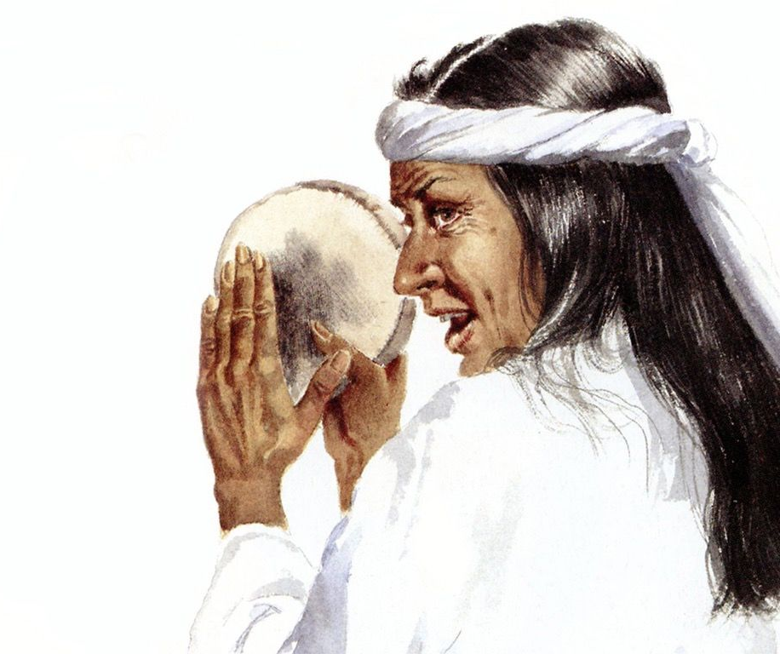
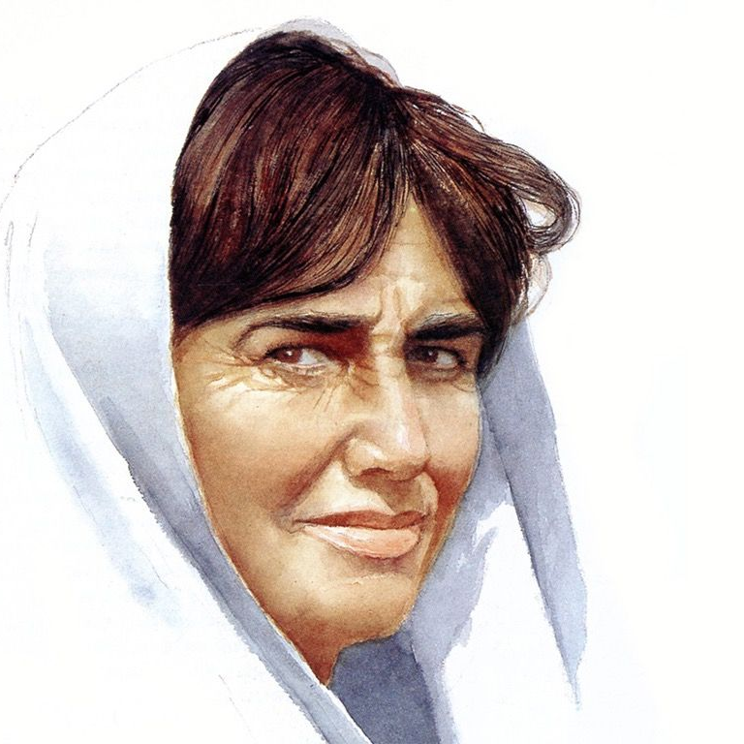
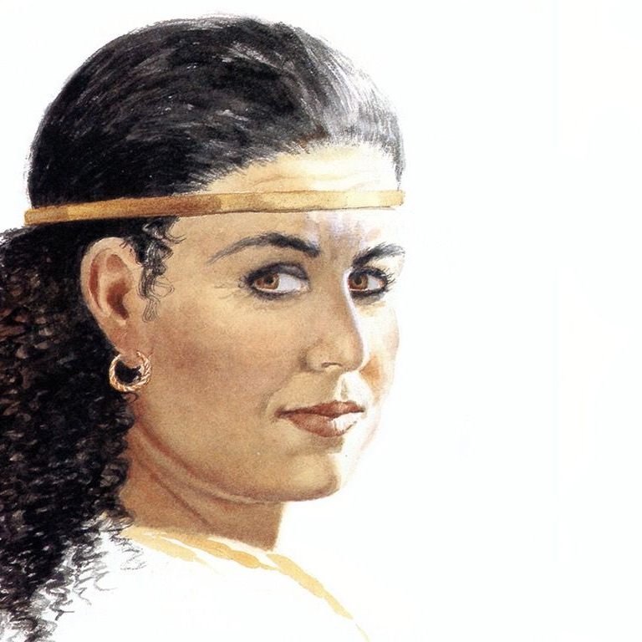
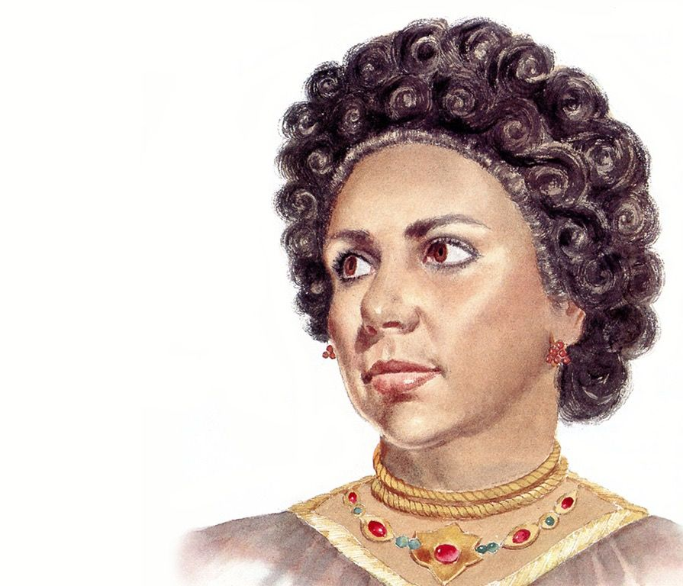
A Bibliában szereplő nők
Ha megnézzük a Biblia néhány női szereplőiről szóló történeteket, beszámolókat, jelentéktelennek tűnhetnek.
Notes:
Women Featured in the Bible
When we look at the stories and historical accounts of some of the women featured in the Bible, they probably appear unremarkable.
Some women might appear as foolish.
Some women might appear as weak.
Some women might appear as despised.
Some women might appear as of no value.
At the most, these women probably appear rather ordinary. Many of them were shockingly lower class women, just as the disciples were considered common men.

Slide 4
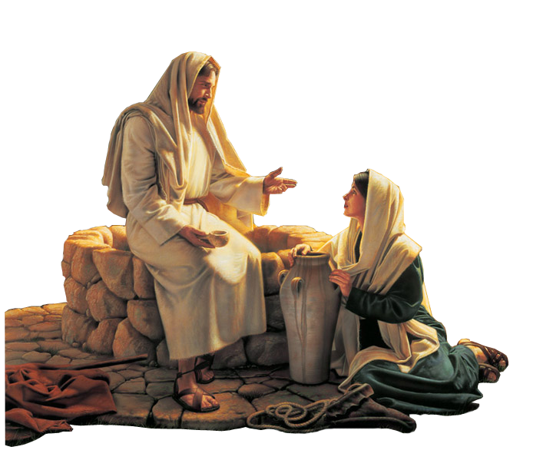
A samáriai asszony
De Isten az Ő bölcsességében ismerve az értéket és rendkívüli ajándékokat, melyeket női teremtményeibe helyezett, úgy döntött, hogy használja amit teremtett az Ő dicsőségére. Isten olyan női vezetőket használt, mint a samáriai asszony, akinek még a nevét sem tudjuk.
Notes:
But God, in His wisdom, knowing the value and extraordinary gifts that He put into His feminine creation, chose to use what He created for His glory. God chose women leaders such as the Samaritan woman whose name we don’t even know.

Slide 5
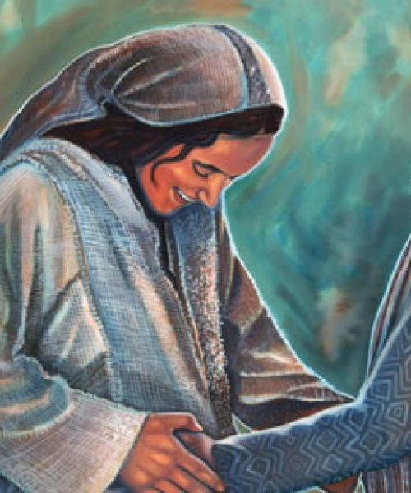
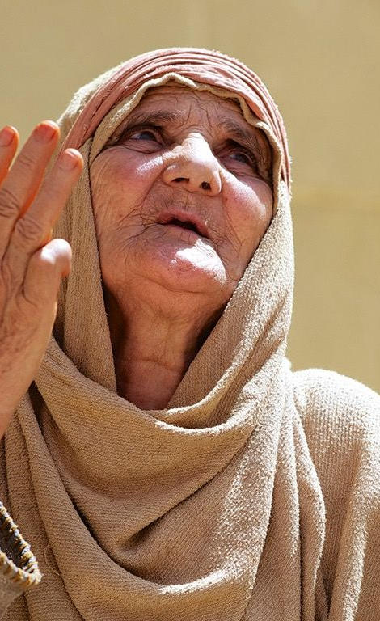
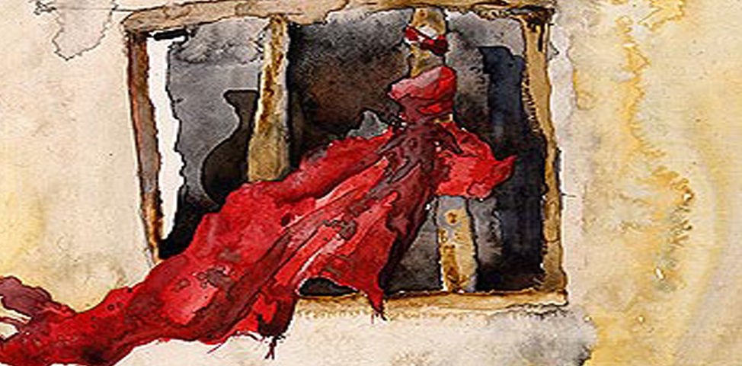
Isten kiválasztotta Annát
Ráhábot
Máriát
Notes:
God chose Anna—an obscure, elderly widow who appears only in one brief
scene in Luke, chapter 2.
God chose Rahab who was a common harlot.
God chose Mary, the mother of Jesus, who was a young girl of no particular distinction, living in a tiny village in a barren and despised district of Galilee.
Actually, the only real exception is Eve; Eve did begin life with some advantages over other women. She was created perfect and quite extraordinary in every way. She was hand-crafted by God to be the pure and pristine ideal of womanhood. She walked and talked personally with God. Still, she, too, became a living example that God can recover and redeem any of us who fall—and make each of us extraordinary trophies of His grace in spite of our failures.

Slide 6

Rendkívüli vezetők
Ezek a nők végül rendkívüli vezetőkké váltak, nem bármiféle saját természetes tulajdonságuk miatt, hanem mert az egyetlen igaz Isten akit imádtak és szolgáltak, aki megalkotta és megajándékozta őket egyenlő vezetői képességekkel, tiszta ezüstté finomította őket.
Notes:
These women ultimately became extraordinary leaders, not because of any natural qualities of their own, but because the one true God whom they worshipped and served, the God who created them and gifted them with equal leadership capabilities, refined them like pure silver.
These Biblical women leaders are reminders of both our fallenness and our potential. One of the unique features of the Bible is the way it exalts women. Have you ever noticed that instead of demeaning or belittling women, Scripture often seems to go out of the way to pay homage to them; the Holy Scriptures ennobles their roles in society and family. The Bible faithfully acknowledges the importance of their influence. In the very first chapter of the Bible we are taught that women, like men, bear the stamp of God’s own image. Wives are seen as partners and cherished companions to their husbands, not merely slaves or pieces of furniture.
And when giving the Ten Commandments, God commanded children to honor both their father and their mother. Today, in our culture, that doesn’t seem –unusual; we would think it as just sensible and good. However, this was a revolutionary concept in an era when most pagan cultures were dominated by men. These pagan men ruled their households with an iron fist, and during this time women were usually regarded as inferior creatures.
Scriptures were actually very revolutionary and forward thinking when they set women apart for special honor (I Peter 3:7). Scriptures command husbands to love their wives sacrificially, as Christ loves the church, even, if necessary, at the cost of their own lives (Eph. 5:25-31).
Close observation of the Biblical accounts of the patriarchs shows us how they always gave due distinction to their wives. Sarah, Rebekah, and Rachel all loom large in the Genesis account of God’s dealings with both them and their husbands.
Miriam, the sister of Moses and Aaron, was both a prophetess and a songwriter, and in Micah 6:4 God Himself honors her right alongside her brothers as one of the nation’s three leaders during the Exodus.
Deborah, also a prophetess, was a judge in Israel prior to the Monarchy. When Solomon (the wisest man who ever lived) became king, he publicly paid homage to this mother, standing when she entered his presence, and then bowing to her before he sat on his throne (I Kings 2:19).

Slide 7

Salamon példabeszéde
Salamon példabeszédeiben a bölcsesség nőként van megszemélyesítve. Nem jelentéktelen tény, hogy mind Izrael, mind az új testamentumi egyház társadalmi és egyházi életében a nők soha nem voltak háttérbe szorítva. A férfiakkal együtt részt vettek minden ünnepen és Izrael nyilvános istentiszteletein. (V. Mózes 16:14; Neh. 8:2,3)
Notes:
In the proverbs of Solomon, wisdom is personified as a woman. It is no small matter that, in the social and religious life of both Israel and the New Testament church, women were never relegated to the background. They partook with men in all the feasts and public worship of Israel (Deut. 16:14; Neh. 8:2-3).
Women were not required to be veiled or silent in the public square, as they are in many pagan middle-eastern cultures even today (Gen. 12:14; 24:16, I Sam. 1:12).

Slide 8
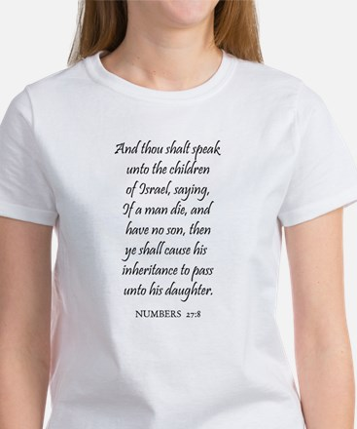
Ellentétek a történelemben
Jézus példát adott szolgálatában azáltal, hogy számos nőt tanítvánnyá tett (Luk. 8:1-3). Erről a gyakorlatról szinte nem is hallottak a kor rabbijai. Ezen felül, Jézus BÁTORÍTOTTA tanítványágukat azáltal, hogy szükségesebbnek jellemezte, mint az otthoni munkát. (Emlékszünk Mária és Márta történetére?). Valójában Krisztus saját azonosságát, mint az igaz Messiást, először kendőzetlenül egy samáriai asszonynak fedte fel.
Notes:
Contrasts in History
Women were landowners in Israel (Num. 27:8; Prov. 31:16). This stands in sharp contrast to the way the ancient pagan cultures routinely degraded and debased women. Women in pagan societies during biblical times were often treated as little better than animals.
Even some of the best known Greek philosophers, considered the brightest minds of their age, taught that women were inferior creatures by nature.
In the great Roman Empire , perhaps the pinnacle of pre-Christian civilization, women were generally regarded as the personal possessions of their husbands or fathers, with little more standing than the household slaves.
Pagan religion fueled and encouraged the devaluation of women even more. Greek and Roman mythology had its goddesses such as Diana and Aphrodite, but this goddess-worship didn’t raise the status of women in society. Ironically, the exact opposite was true. Most of the temples devoted to goddesses were served by sacred prostitutes, women serving as priestesses who sold themselves for money, supposing they were performing some kind of a religious sacrament.
Male pagan deities with their religious ceremonies were blatantly obscene, including erotic fertility rites, drunken temple orgies, perverted homosexual practices, and in the very worst cases, even human sacrifices. Why should we mention all this when we address the topic of women in leadership for our church in the 21st Century? Because Christianity was born in a world where Roman and Hebrew cultures intersected, and this very Christianity, the core of our church today, elevated the status of women to an unprecedented height.
Jesus provided a model in His ministry by including several women as disciples (Luke 8:1-3), a practice almost unheard of among the rabbis of His day. Not only that, but Jesus ENCOURAGED their discipleship by portraying it as something more needful than domestic service. (Remember the Mary and Martha story?) In fact, Christ’s first recorded explicit disclosure of His own identity as the true Messiah was made to a Samaritan woman.
Christ always treated women with the utmost respect, even women who were otherwise regarded as outcasts by society and sometimes by His own followers. Therefore, because of Jesus’ example in elevating the status of women, it is no surprise that women became prominent in the ministry of the early church.
On the day of Pentecost, when the New Testament church was born, women were there with the chief disciples, praying (Acts 1:12-14). Some women were renowned for their good deeds and others for their understanding of sound doctrine and their spiritual giftedness (Acts 18:26; 21:8,9).
John’s second epistle was addressed to a prominent woman in one of the churches which was under his care. Even Paul, who is sometimes misunderstood and accused of being a male chauvinist, regularly ministered along with women (Phil. 4:3).

Slide 9
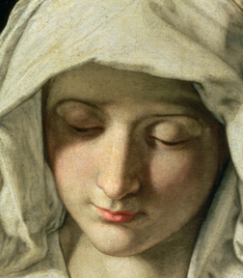
Ahogy a kereszténység kezdett hatással lenni a helyi kultúrára, a nők helyzete drámaian javult. Egy ős keresztény történész, Tertullianus, azt írta, hogy azok a pogány nők, akik bonyolult hajkölteményeket, szemérmetlen öltözetet viseltek, valójában a társadalom és divat kényszerítette őket, hogy feladják igazi nőiességük nemesebb ragyogását.
Notes:
As Christianity began to influence local culture, the status of women was dramatically improved. One early church historian, Tertullian, wrote that pagan women who wore elaborate hair ornaments, immodest clothing and body decorations had actually been forced by society and fashion to abandon the superior splendor of their true femininity.
He noted that by contrast, as the Christian church had grown and the gospel had borne fruit, one of the visible results of Christianity was a trend toward modesty in women’s dress and a corresponding enhancement of the status of women. He recorded that pagan men commonly complained, “Ever since she [his wife] became a Christian, she walks in poorer garb.” Obviously, pagan men realized that Christianity regarded a woman as more than a sex symbol or piece of cheap property.
Clearly these first Christian women elevated feminine virtue to such an unprecedented height that even the pagans recognized it. Chrysostom, an eloquent preacher from the 4th century, recorded that one of his teachers, a pagan philosopher named Libanius, once said, “What women you Christians have!”
After Constantine was converted in 312 AD, Christianity was granted legal status in Rome and soon became the dominant religion throughout the Empire. One of the early results was a whole new legal status for women. Rome passed laws recognizing the property rights of women. Legislation governing marriage was revised so that it was now legally seen as a partnership. And, throughout history, when we look closely we see that this has s been the trend that follows the spread of Christianity.

Slide 10

Általában ahol az evangéliumot sikeresen bemutatták, a nők társadalmi, jogi és lelki megítélése javult.
Notes:
Generally, wherever the gospel has been successfully presented, the social, legal, and spiritual status of women has been elevated. Sadly, when this transforming gospel has been ignored or eclipsed—whether by repression, false religion, secularism, humanistic philosophy, or spiritual decay within the church—the status of women has declined accordingly. It is important to remember that Christianity values and validates the talents and spiritual gifts of women, their servant-leader potential, as bestowed of God.

Slide 11
Nézzünk meg néhány bibliai példát női vezetőkre
Notes:
Biblical Examples in Leadership
Let’s now look at some Biblical examples of Women in Leadership.

Slide 12
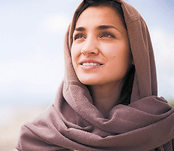
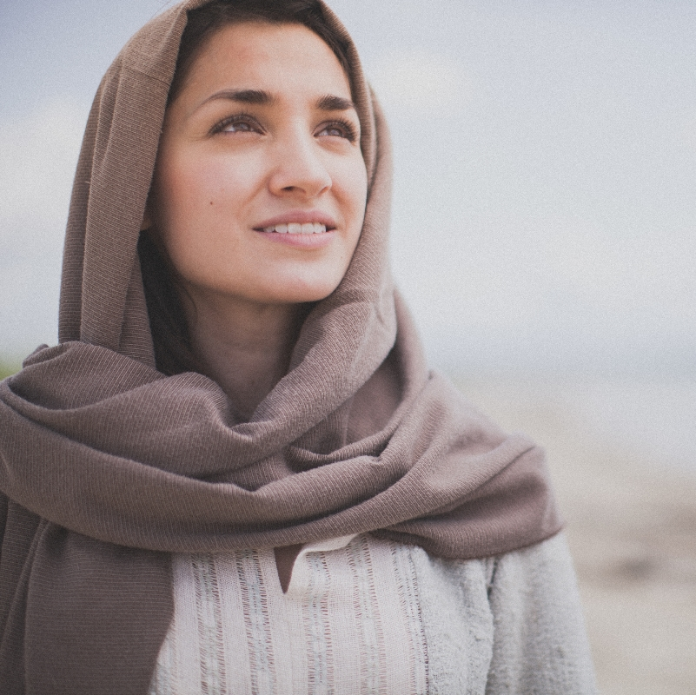
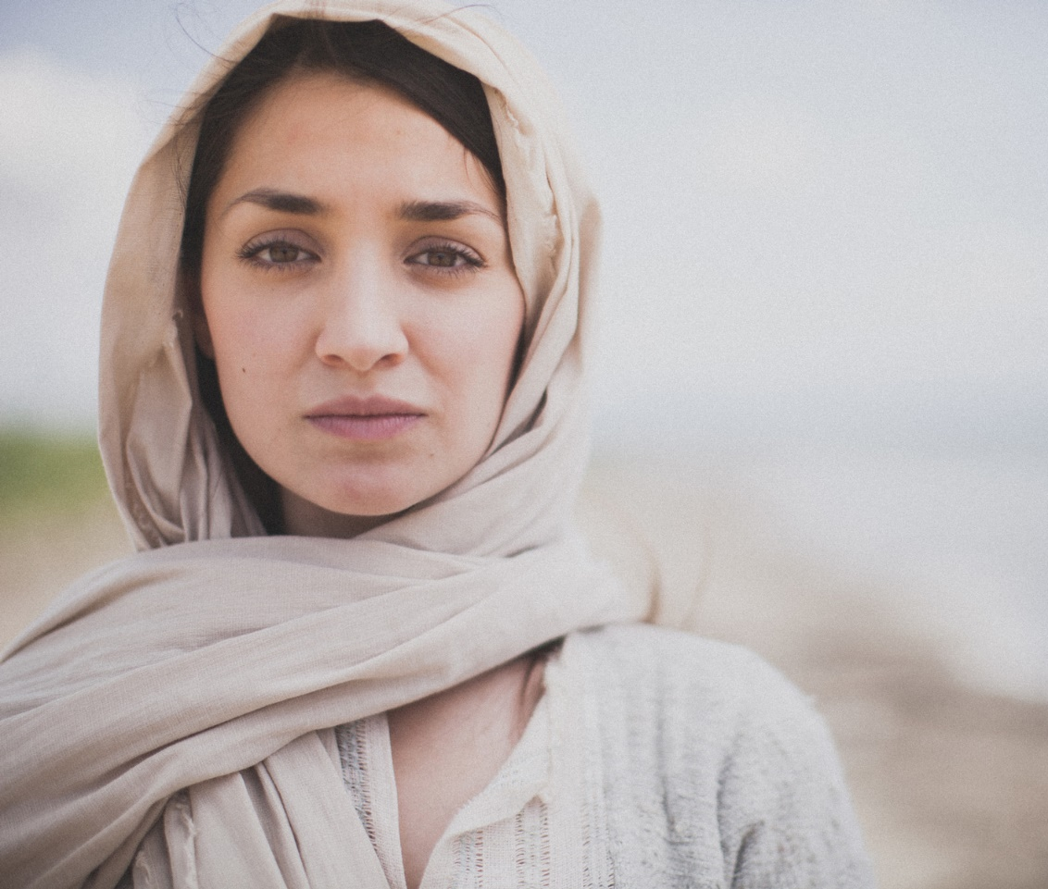
Bírák 4 és 5
DEBORAH TÖRTÉNETE
Notes:
The Story of Deborah (Judges 4-5)
Jericho had been in ruin for 200 years. The Israelites had swept across the country like a swarm of locusts, pretty much taking everything in their path, but somehow the indigenous people had managed to survive, and, like well-rooted weeds, their idolatry still spread until it began to strangle Israel’s faith.
Rahab and Joshua were only memories, and the Israelite slaves, who had once been warriors, were again the underdogs. For twenty years they were cruelly oppressed by Jabin, the king of Canaan. His chief general was Sisera. Sisera had nine hundred iron-plated chariots, which rightfully terrified the Israelite people. This was the equivalent of nine hundred of today’s huge army tanks. Sisera probably felt quite smug and secure, especially since Israel was now led by a woman, Deborah.
Deborah was a prophetess who held court under a palm tree named – you guessed it – Deborah’s Palm. The odds of nine hundred large tanks against one little woman sitting under a palm tree seemed pretty well already decided.
Deborah, who lived several miles northwest of Jericho, was a judge over Israel. The people of Israel went to her to have their disputes decided. She was a leader who had refused to lose faith, despite the sad circumstances surrounding her.
One day she summoned Barak, a Jew from the north, and told him plainly, “The Lord, the God of Israel, commands you: ‘Go, take with you ten thousand men of Naphtali and Zebulun and lead the way to Mount Tabor. I will lure Sisera, the commander of Jabin’s army, with his chariots and his troops to the Kishon River and give him into your hands’.”
But, like every other man in Israel, Barak was terrified of Sisera and refused to obey her command except on one condition—that she would accompany him.
“Very well,” she replied, “I will go with you, but because of your bad attitude and the way you are going about this, the honor will not be yours, for the Lord will hand Sisera over to a woman.”
With this stipulation and prophecy, Deborah went with Barak. Sisera, in the meantime, heard about the plot and led his troops and chariots to the Kishon Wadi, a dry riverbed, determined to crush this uprising. But his very strength turned against him as the Lord sent rain and swelled the valley to floodtide. Suddenly, nine hundred chariots became a huge liability. They quickly became stuck in the mud, easy targets for Barak’s troops which swept down from Mount Tabor, killing everyone except Sisera.
That is the story of Deborah’s leadership. Scripture describes Deborah as a “prophetess, the wife of Lappidoth.” But when Deborah described herself, she didn’t use terms like prophet or judge or general or leader. She described herself as “a mother in Israel” (Judges 5:7).

Slide 13

Megbeszélendő kérdések
Mit gondolsz, milyen volt egy átlagos izraeli család élete a 20 éves Jabin elnyomás alatt?
Mit gondolsz, mire gondolt Deborah amikor azt mondta : “Megszűntek a kerítetlen helyek Izraelben, megszűntek végképpen,; Mígnem én Debora felkelék,; Felkelék Izrael anyjaként.”? (Bírák 5:7)
Személyesen hogyan reagáltál volna Siserara? Mint Deborah? Vagy mint Barak?
Mitől félt Barak? Miért nem akart Deborah nélkül menni?
Szerinted hogyan érezték magukat az izraelita férfiak Deborahnak és Jahelnek a győzelemért járó tisztelet miatt?
Amikor ma egy nő túlszárnyal egy férfit a gyülekezetben, hogyan reagálnak a tagok?
Notes:
Questions for discussion
What do you think life was like for the average family in Israel during the 20 years of oppression by Jabin?
What do you think Deborah meant when she said: “Village life in Israel ceased, ceased until I, Deborah, arose, a mother in Israel”? (Judges 5:7).
What do you think your personal reaction would have been to Sisera? Would you have been like Deborah? Like Barak?
What was Barak afraid of? Why would he not go without Deborah?
How do you think the Israelite men might have felt about the honor for this victory going to Deborah and Jael?
6. When a woman in our church today outshines a man, what are some reactions of church members?

Slide 14
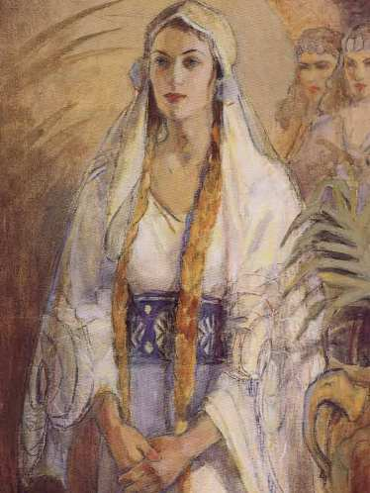
II.Királyok 22:14-20 II.Kron. 34:14-33
HULDAH TÖRTÉNETE
Notes:
King Josiah ordered Shaphan, the royal secretary, to count the money and distribute it to the foremen working on the temple so they could settle up with their workers. When Shaphan showed up to collect the funds, Hilkiah, the high priest, tells him that he has discovered a long-forgotten book of God that has been hidden in the temple. Shaphan reads the book and then comes back to Josiah and tells him about the book and what it says. When Josiah hears the terrible prophecies of the book, he is distraught and tells five his closest advisors to “go to the temple and speak to the Lord for me and for all the remnant of Israel and Judah” to find out what they should do.
Interestingly, instead of following the instruction of the king, the advisors immediately go to Huldah the prophetess. Huldah studies the words. She was probably distraught about having to tell the advisors such terrible predictions, but I believe that her voice was steady. Perhaps the terrible threats made her eyes well over. She remembered the prophets who were murdered, while diviners and sorcerers were honored. She thought about kings who bowed down to the stars and people who following suit.
Huldah is one of only four women with an authentic prophetic ministry mentioned in the Old Testament. The others were Miriam, Deborah and Isaiah’s wife. Although prophets such as Jeremiah and Zephaniah were also active at this time, King Josiah‘s advisors did not go to them but instead consulted Huldah about the amazing discovery of the Book of the Law.
Huldah surely knew the sordid details of the past. She may have endured part of Manasseh’s 55 year reign, which was the longest and worst of any king in Judah. She was certainly heartened by the recent reforms of King Josiah. However, 35 years after Huldah’s prophecies, Judah was taken in chains to Babylon and all of its cities were destroyed.
She told the advisors that since Josiah was taking this doom so seriously, if he continued following the Lord’s leading, he would die a quiet death and be buried in peace. It is a sad note that Josiah did not at the very end listen to God, and in fact, was killed in a battle with the king of Egypt.
The advisors took Huldah’s message back to Josiah, and he began a house-cleaning of all the pagan sites to be burned—the sex-and-religion shrines, the altars for idol worship, and the altar of Molech (to whom the people sacrificed their sons and daughters). How unbelievably low the people of Israel had fallen.

Slide 15
Megbeszélendő kérdések
Nyilvánvalóan Huldah az otthonából jövendőlt, hiszen ott találták meg a szent emberek. Szerinted miért otthonról intézte lelki dolgait? Ma hogyan szolgálhatnak a nők otthonról?
Huldah hűséges prófétanő volt egy nemzeti hűtlenségi időszakban. Szerinted ma hogyan segíthetnek Istent félő nők, hogy megerősítsék egyházunkat és bemutassák hűségüket?
Minden nő ismeri a tiszta ház adta megelégedettség érzését. Miután hallották Huldah szavait, Jósias király egész palotáját és királyságát megtisztította lelkileg. Hogyan tisztíthatnánk meg otthonunkat és életünket lelkileg?
Notes:
Questions for discussion
Evidently Huldah prophesied from her home since that is where the holy men found her. Why do you think she was doing her spiritual business from her home? What are some ways women today can minister from home?
Huldah was a faithful prophetess during a time of national unfaithfulness. How do you think Godly women today can help strengthen our church and model faithfulness?
Every woman knows the contentment of a clean house. After hearing Huldah’s words, King Josiah gave his whole palace and kingdom a thorough spiritual cleaning. How can you and I give our homes and our lives a spiritual cleaning?

Slide 16
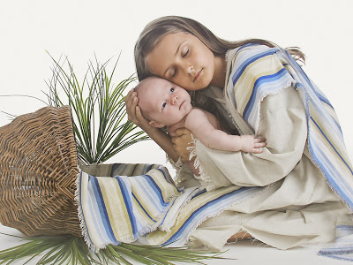
II. Mózes 2:1-10; 15:20,21; IV.Mózes 21:1-15
MIRIAM TÖRTÉNETE
Notes:
3. The Story of Miriam (Ex. 2:1-10; 15:20-21; Num. 21:1-15)
Miriam was just a young girl herself when she hid her little brother Moses in the bulrushes of the River Nile to save his life. Even as a youngster she perfectly carried out God’s plan to preserve Moses’ life for his great leadership commission. As a young woman she showed exceptional qualities of obedience and servitude to God which are the prerequisites of leadership.
When the children of Israel were finally safely out of Egypt, it was Miriam, who led the Israelite women in praise to God for the miraculous defeat of the Egyptians at the Red Sea. “Then, Miriam the prophet, Aaron’s sister, took a tambourine and led all the women in rhythm and dance” (Ex. 15:20).
Miriam was strong and God-filled in her leadership. That was, until she decided to criticize Moses, or specifically, criticize his wife. Miriam and Aaron criticized Moses because he had married a Cushite woman. Miriam’s sin was most likely a sin of pride. She thought herself better than Moses’ wife. After all, what part did this wife, who was a foreigner, know about all their suffering for the long years in Egypt? Miriam had endured cruelty and discrimination at the hands of the taskmasters of the Pharaoh. She had daily witnessed her family’s suffering and her people’s misery. What did this foreign woman know about suffering or pain? She had lived a life of privilege on her rich father’s farm. She had no idea of what life had been like for those growing up in the misery of slavery.
God heard the criticism and immediately told all three of them—Moses, Aaron and Miriam—to go out to the tabernacle. Then the Lord came down in a cloud and stood at the entrance. He told them He had a very special relationship with Moses and was furious with the other two for criticizing. As the Lord moved away, He struck Miriam with leprosy.
Aaron and Moses begged God not to punish her, but the Lord stood firm. She had to endure seven days of the terrible disease, but then she was restored to her position of leadership. Miriam had received and endured her immediate punishment for her sin. She probably resumed her leadership responsibilities a much wiser woman.

Slide 17
Megbeszélendő kérdések
Miriam már egészen fiatalon vezetői tulajdonságokkal rendelkezett. Higgadt és magabiztos maradt Egyiptom hercegnőjével való beszélgetés során. Mit gondolsz a mai Istent félő nők fel kell-e ismerjék és ki kell-e fejlesszék ezeket az Isten- adta vezetői készségeket a fiatal lányokban? Bátorítanunk kell-e ezeket a lelki ajándékokkal rendelkező fiatal nőket, hogy fejlesszék ezeket a készségeiket?
Miriam istentiszteletet vezető nő volt amikor hálaadásra szólította a nőket a csodás szabadulás után a Vörös tengernél. Isten örült ennek. Ma hogyan tudnánk abban vezetni más nőket, hogy megváltás ajándékát ünnepeljék? Szerinted milyen megfelelő módot találunk erre?
Szerinted miért gondolta Miriam, hogy jobb, mint Mózes felesége? Szerinted azt gondolta, hogy öröksége és vezetői képessége jobbá tették, a kushita nőknél? Hogyan reagálunk hasonló hozzáállásokhoz? Csak legbensőnkben válaszoljunk, és kérdezzük meg magunktól „Kihez képest érzem én magasabb rendűnek magam?”
Szerinted miért csak Miriam kapott büntetést és Áron nem? Ő lehetett a „ bandavezér” ebben a bírálatban?
Milyen tanulságokat vonhatunk le Miriam tapasztalatából mások megítélésével kapcsolatban, különösen vezetőket, vagy házastársaikat illetően?
Miriam elfogadta büntetését és úgy tűnt, hogy alázatosan fogadta el. Mit szólnál, ha mi élnénk át egy hét kötelező „szabadságot”? Istennel való kapcsolatunk építésére fordítanánk, vagy hibáztatnánk Őt helyzetünkért?
Notes:
Questions for discussion
Miriam exhibited leadership qualities even as quite a young girl. She remained poised and confident in her interaction with the Princess of Egypt. Do you think Godly women today should recognize and cultivate these God-given leadership skills in our young girls? Should we encourage these spiritually-gifted young women to pursue their talents?
Miriam was a very spiritual worship leader when she moved the women into thanksgiving after the miraculous deliverance at the Red Sea. God was pleased. How can we today lead other women into celebration for the gift of salvation? What are some ways you think might be appropriate?
3. Why do you think Miriam thought she was better than Moses’ wife? Do you think she thought her heritage and leadership gifts made her better than “the Cushite woman”? How do we at times reflect similar attitudes? Answering only in our inmost hearts, let’s ask ourselves, “Whom do I feel superior to?” (Allow a few moments of silence for reflection.)
4. Why do you think only Miriam received the punishment and not Aaron? Was she perhaps the ring-leader in this criticism?
What are some lessons we can learn from Miriam’s experience about judging others, especially leaders and/or their spouses?
6. Miriam accepted her punishment and seemed to receive it humbly. What would you or I think about if we experienced a mandatory week’s “time out” Would we use it to build our relationship with God, or spend it blaming Him for our situation?

Slide 18

I. Sám. 18:20-29; 19:11-17; II. Sám. 6:16-23
Mikál története
Notes:
4. The Story of Michal (I Sam. 18:20-29; 19:11-17; II Sam. 6:16-23)
Michal was in love with David, the handsome king-to-be. Saul, her father, was pleased. Saul plotted to use her love for David to his own benefit. So he let her marry him; then tried to use her as an inside traitor, hoping she would eventually betray David out of loyalty to her father. And it seems that David, from a humble background, was delighted to have a princess for his wife.
The scripture mentions several times how much Michal loved David. David had been the musician who played his harp for her father. Maybe the romance began over his music. After David defeated Goliath with only a sling and a stone, not only Michal but all of Israel fell in love with him. But it was for her love alone that David had slain two hundred Philistines. He was considered a fit husband for a princess.
After they were married, Michal saved David’s life when her father tried to kill him. Using her imagination and creativity she helped him escape out a window, then stuffed his bed and pretended he was sick.
Although Michal had saved his life, David did not return for her. Their separation became a long one. Perhaps she believed David would find a way to protect her from her father’s wrath and was disappointed when time passed and there was no sight of her Prince Charming.
Her disappointment grew into bitterness when David never returned for her. She felt betrayed and was probably shocked and her dreams completely shattered when her father punished her loyalty to David by forcing her to marry Palti, whom she didn’t love. After a time, she had finally built a relationship with her new husband, who loved her, but then her brother showed up and forcibly took her away.
The Bible says Palti followed along behind her as far as Bahurim, weeping as he went. But when Abner insisted that he go home, he went (II Sam. 3:16).
Michal’s story is tragic. Her bitterness seems to have swelled to rage when she realized she had always been someone else’s pawn. She was first a princess and then a queen, but her potential for leadership had been used by her father for his own agenda. And then she had been used by her beloved David, for his revenge at Saul by taking her, not to love but to be a trophy.
From one window scene to another, only nine years had passed from the time she helped David escape through the window until she is at the window again, this time watching David, and resenting him.
In the first window scene she is addressed as Saul’s daughter, in the second window scene as David’s wife. Scriptures say she spoke to him in disgust. Silence probably spread like thickening ice in winter cold between David and Michal. This queen-leader ended her days alone, with neither children nor family to warm her.

Slide 19
Megbeszélendő kérdések
Mikál, elsőszülöttségi jogon vezetésre született. Szerinted nehezebb a vezetés, ha „elvárják” azért akik vagyunk? Miért?
Valaki olyanban való csalódottság akit ő szeretett kiábrándultsághoz, hitetlenkedéshez, és kétségbeeséshez vezetett. Mikál várta Dávidot, hogy visszatér és megmenti Saultól, mert ő is megmentette tőle. Hogyan tartózkodhatnak a mai nők attól, hogy másokra megmentőjükként tekintenek? A női vezetők hogyan tudnak megküzdeni azokkal, akik kiábrándítják őket?
Mikál másodszor már rátalált egy beteljesítő kapcsolatra, de újra csak elszakította őt az elsőszülöttsége miatti hatalomért való küzdelem attól, akit igazán szeretett. Szerinted a női vezetőknek nehéz különbséget tenni azok között akik barátságosak azért amit kaphatnak és azok között akik barátok azért amit adhatnak?
Notes:
Michal, by her birthright, was born with credentials for leadership. Do you think leadership is more difficult when it is “expected” because of who we are? Why?
Disappointment in someone she loved started Michal down a track of disappointment, disbelief and despair. Michal expected David to come back and save her from Saul because she had saved him from Saul. How can women leaders today keep from looking to other people as their saviours? What are some ways women leaders can cope with those who disappoint them?
3. Michal found a contented relationship a second time, but again, a fight for power over her birthright tore her from someone who truly loved her. Do you think women leaders have difficulty distinguishing between one who is friendly because of what they can get and one who is a friend because of what they can give? What are some distinguishing characteristics of these two types of friends?

Slide 20
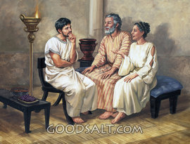
Acs. 18-19; Róm. 16:3,4; I. Kor. 16:19; II. Tim. 4:19
PRISCILLA TÖRTÉNETE
Notes:
5. The Story of Priscilla (Acts 18-19; Rom. 16:3-4; I Cor. 16:19; II Tim. 4:19)
When Claudius expelled the Jews from Rome in AD 49, because he was tired of their constant bickering about Christ, Priscilla and Aquila moved to Corinth. Corinth was a commercial trade center famous for its appetite for mischief, not much of a place to nurture the faith of a new believer. Yet that was where God transplanted Priscilla and her husband, Aquila.
About a year later, Paul arrived in Corinth. He probably met the couple through their common trade as tentmakers. Priscilla and Aquila invited Paul to stay in their home and work with them. Paul preached the gospel and managed to generate both faith and opposition. Eighteen months later, Jewish leaders of Corinth hauled him before the council. When the charges were dismissed, Paul quickly set sail for Ephesus, taking Priscilla and Aquila with him.
Paul worked with Priscilla and Aquila for three years before he left them as leaders of the church in Ephesus. One day Apollos, a native Jew of Alexandria, arrived and began preaching eloquently about Jesus. But he really understood only some shallow basics of the Gospel. Rather than denouncing him for his inadequate presentation, Priscilla and Aquila took him aside and instructed him. They did their job so well that the believers in Ephesus eventually sent him to Corinth where he advanced the work.
Priscilla must have been a spiritually mature woman whose gifts equipped her for leadership. Her name precedes Aquila’s four times out of the six times they are mentioned in the New Testament, probably signifying her greater abilities as a leader.
Whatever the case, Priscilla’s role in instructing Apollos and leading the early church is remarkable. Along with Aquila, she was the best friend Paul could have had, helping him establish the church and risking her life for his sake.
Paul mentions the couple’s courage in one of his letters but doesn’t elaborate on the circumstances. She helped establish the early church amid an atmosphere of great hostility, risking her own life for the sake of the gospel she loved.

Slide 21
MEGBESZÉLENDŐ KÉRDÉSEK
Priscilla és Aquila együtt elment Korinthusból és Efézusba már Pállal mentek. Mit gondolsz a kapcsolat dinamikájáról amikor a párok egyformán vezetők? Milyen érvek szólnak amellett / ellen ha az egyik vezető hátra marad és pénzt keres, míg a másik tovább megy egyedül?
A Szentírás arról számol be, hogy Priscilla és Aquila tanácsolták Apollóst. Útmutatásaik bizonyára sikeresek voltak, ami látszik későbbi gyümölcsöző szolgálatából. Szerinted mi lett volna Apollós reakciója ha mind a nő, mind a férfi tanította volna? Miért négyszemközt tanították?
Notes:
Questions for discussion
Priscilla and Aquila left Corinth together and went with Paul to Ephesus. What do you think the dynamic might be when couples are equal leaders? What do you see as the pros and cons when one leader stays behind to earn a living while the other leader moves on alone?
Scriptures tell us that Priscilla and Aquila took Apollos aside and instructed him. Their instruction must have been successful because of his later fruitful ministry. What do you think Apollos’ reaction might have been to being taught by both a man and a woman? Why would they instruct him in private?

Slide 22
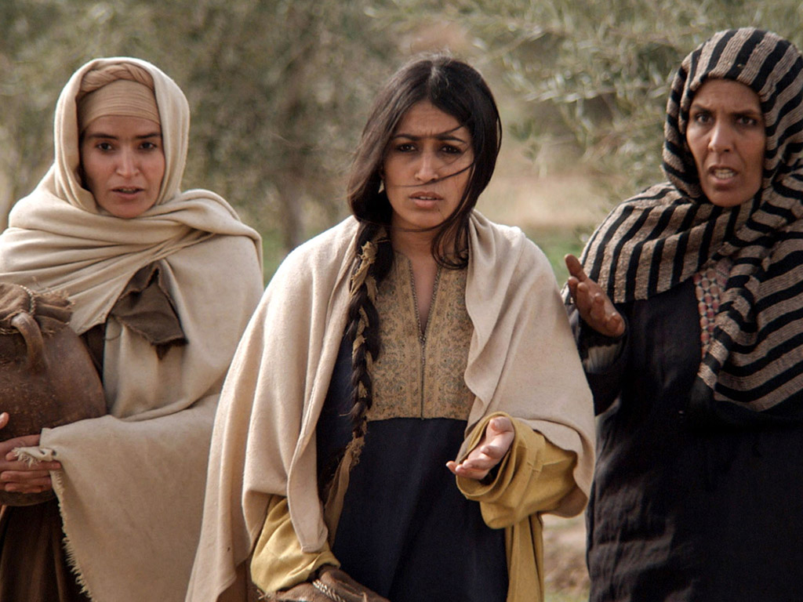
Ezen lelki vezetők történetei a mi tanulságunkra és megjobbításunkra írattak meg. Bárcsak tanulnánk belőlük és válaszolnánk Isten személyes hívására, hogy betőltsük azt a lehetőséget amivel megajándékozott Bennünket.
Notes:
In these few stories of women leaders of Bible times, we learn valuable lessons to encourage and enlighten us today. These women showed courage, talent, ability and spiritual strength. God called them, as He calls women today, to offer their gifts of leadership service to His glory.
The stories of these spiritual leaders are given to us “for our ensamples: and they are written for our admonition….” May we learn from them and answer God’s call to each of us to fulfill all the potential with which He has gifted us.

